Slide 1
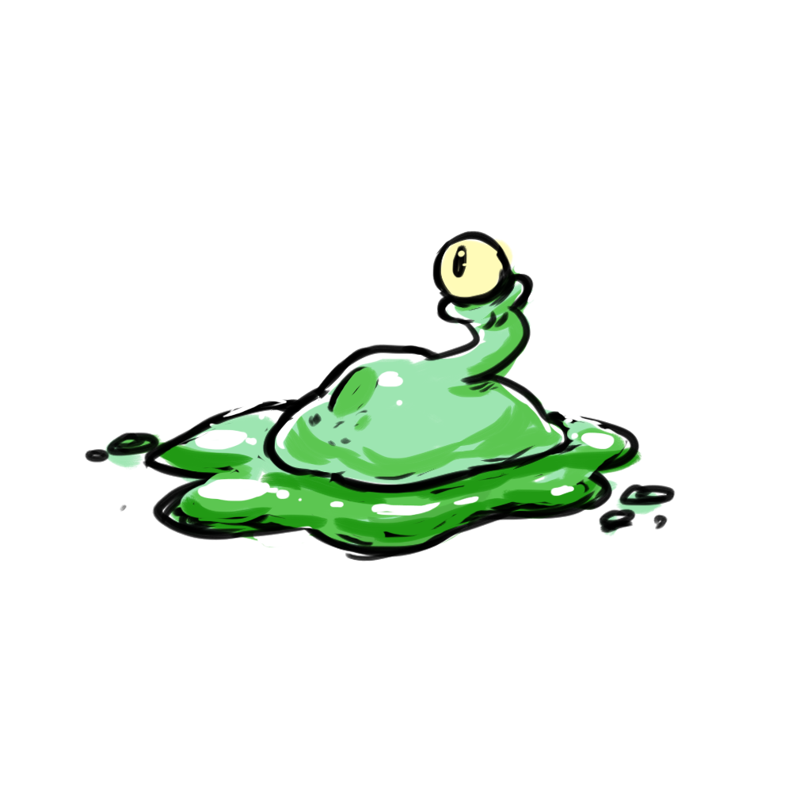
Alien Clean Up
(Placeholder Title)
CMPS-115 Summer 2018
Team Ｓ Ｌ Ｉ Ｍ Ｅ Ｂ Ｏ Ｙ Ｓ
Team Members: Dmitry, Ben, Marlo, Brendan
Product owner: Stephen
Scrum Master: Riley

Slide 2
Alien Clean Up
Our Pitch
A feature complete multiplayer game. A team of up to 3 “aliens” and 1 “janitor” compete against each other for control of a secret laboratory. Aliens cover the lab in slime while the janitor tries to keep the lab clean. Who ever has more area under their control at the end of the match wins.

Slide 3
Alien Clean Up
High level goals
A working game that is fun to play with friends.
Complete functionality (Menus, supporting different number of player)
Visuals (sprites, textures, etc.)
A relatively polished product, minimal bugs or missing features.

Slide 4
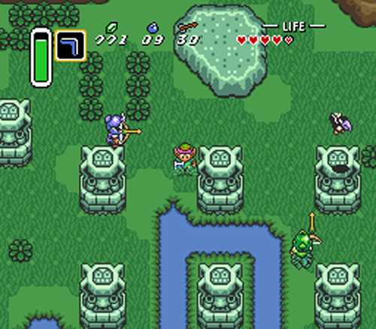
Alien Clean Up
Outline
Built in Unity 2018.1.6 engine
Isometric camera view (ex. Link to the past)
Grid arena used to determine area that is covered with slime or is clean.
Multiple players on local machine. (possibly over online network if time permits)

Slide 5
Alien Clean Up
User Stories
As an alien player my goal is to spread slime across the arena and cover as much area as possible. Will use controllers connected. (possible integrate android phone controls)
As the janitor I will try to clean up slime and possibly obstruct the slimes from covering more area. Will also use controller.
As a player I would like to be able to traverse the menus and set up the parameters (time, # of rounds, items on or off ) of the game before I start playing the game.

Slide 6
Alien Clean Up
Sprint 1: Working Foundation
(5) As a Team, we want everyone to have some basic knowledge of Unity Engine. (3) As a Player, I want to be able to control my character.
(8) As a Player, I want a game that can be won or lost. (5) As a Player, I want a field to play on, so that we can compete with the other team (slimes or cleaner). (3) As a Player, I want a form, so that I know where I am.

Slide 7
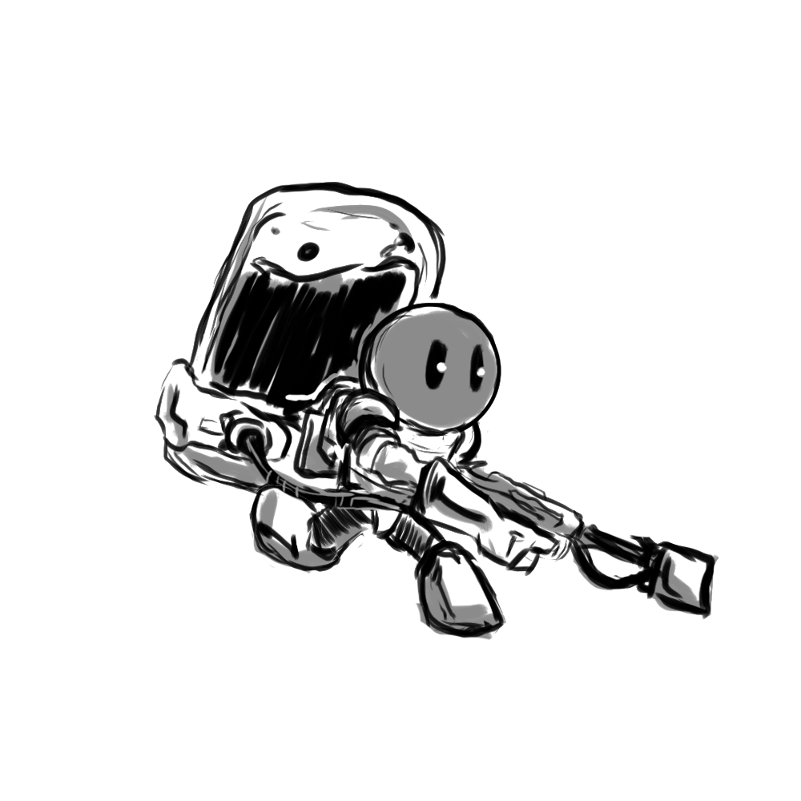
Alien Clean Up
Sprint 2: Fleshed Out Mechanics
(8) As a Player, I want to have a unique character to distinguish me from the rest of the players. (8) As a Player, I want the game to have a number of things I can do while playing.
(5) As a Player, I want menus to select game options with.

Slide 8
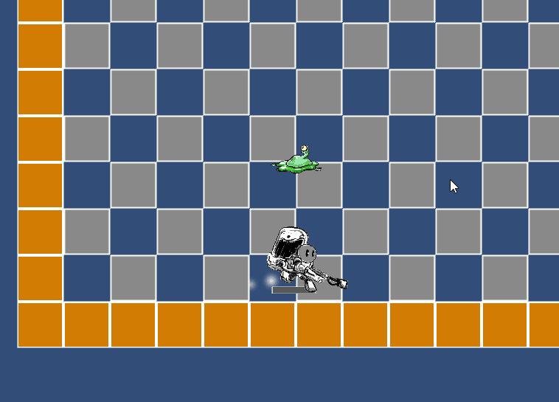
Alien Clean Up
Sprint 3: Feature Complete & Polish
(8) As a Player I want to have varying game play and lots of things that I can use to aid my victory. (5) As a Player I want different maps that I can choose to play on. (13) As a Player I want the game to have JUICE (Visual feedback and polish, satisfying game feel)

Slide 9
Alien Clean Up
Challenges/Risks
Time constraints
Several members are unfamiliar with Unity
Producing game assets ex. Art, animation, sound
Online multiplayer and integration of Android phone
Over extending on a feature of the game and not being able to finish it
Game not being fun

Slide 10



Alien Clean Up
Technologies
Language: C#/Java
Unity 2018.1.6f1 engine
Photoshop / gimp

